Slide 1
INTRODUCTION TO TESTING & TESTING TYPES

Slide 2
Introduction to Testing

Slide 3
Discuss the Overview of Testing Life Cycle
List the Types and Levels of Testing
Explain Static Testing Techniques

Slide 4
Overview of Testing Lifecycle

Slide 5

WHAT IS A TEST?
A test is an activity in which a system or component is executed under special conditions, the results are observed or recorded, and an evaluation is made of some aspects of the system or component.

Slide 6
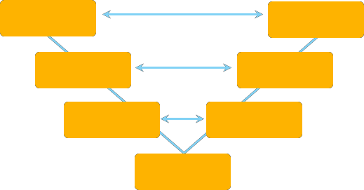
WHERE TESTING FITS IN SDLC?
The left side of the model is Software Development Life Cycle or SDLC
The right side of the model is Software Test Life Cycle or STLC
Each phase comprises independent set of development and testing activities
A good example of development lifecycles following an iterative method can be an Agile Development
Requirement analysis
System testing
High level design
Integration testing
Low Level Design
Unit testing
Coding

Slide 7
SDLC - VERIFICATION AND VALIDATION MODEL
The different phases of Software Development Cycle are:
Requirement gathering: One needs to gather as much information as possible about the details and specifications of the desired software from the client
Design plan: Programming languages like Java, PHP, .NET, and database like Oracle, MySQL, and so on that would be suited for the project, also high- level functions and architecture
Built: Coding the software
Deployment: One needs to deploy the application in the respective environment
Testing: Software testing is done
Maintenance: Once your system is ready to use, you may require to change the code later on as per customer request

Slide 8
SDLC - VERIFICATION AND VALIDATION MODEL
Conclusion:
Testing is not a stand-alone activity, and it has to adapt the development model chosen for the project.
In any model, testing should performed at all levels i.e. right from requirements until maintenance.

Slide 9





VERIFICATION AND VALIDATION MODEL
Stakeholder Requirements and Needs
Satisfaction of Customer Needs
Deployed capabilities
Production Readiness Review
Business Objectives or Requirements
System Validation
System Acceptance Operability
Business Requirements Review
System or System Integration Test
Functional
Non-Functional
System Verification
System Requirements
or Design
System Requirements Review
Test Readiness Review
Component Test
Functional
Non-Functional
Component verification, system integration, system verification, validation, and, acceptance
Component Requirements and Design
Component Verification
System analysis, decomposition, and design synthesis
Preliminary Design Review or Critical Design Review
Product Development

Slide 10
MAPPING OF PROJECT PHASE TO TEST DELIVERABLES
Business Requirements
Objectives, Customer Expectations, and Initial Business Plan
System Requirements
User Scenarios and System Externals
Master Test Plan
Business or Product Function Matrices
Test Cases
System Verification Plan
System Design
Internals, Functions, and Interfaces Test Cases
Integration Feature Test Plan
Build
Logic and Code
Test Cases Unit Test Plan
Install
Integration Testing
System Testing
System Integration Testing
Acceptance Testing
Unit Testing
Execute

Slide 11
QUIZ QUESTION
Software testing activities should start:
As soon as the code is written
During the design stage
When the requirements have been formally documented
As soon as possible in the development lifecycle
Notes:
Answer:As soon as possible in the development lifecycle

Slide 12
TESTING LEVELS
Black Box and White-Box testing
Unit testing
Integration testing
System testing
System integration testing
GUI testing
Alpha testing
Beta testing
Benchmarking

Slide 13
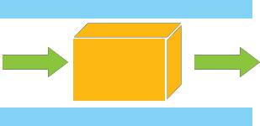
BLACK BOX TESTING
Black box testing is either functional or non-functional, without reference to the internal structure of the component or system.
Select test cases based on an analysis of the specification, either functional or non- functional, of a component or system without reference to its internal structure.
Example: A tester, without knowledge of the internal structures of a website, tests the web pages by using a browser; providing inputs (clicks, keystrokes) and verifying the outputs against the expected outcome. (To display Gmail Page - Opening the URL, enter Username Password and click on Submit).
Black Box Testing
Input
Executable
program
Output

Slide 14
WHITE BOX TESTING
White box testing is the type of testing in which the internal structure/ design/Logic/ implementation of the item being tested is known to the tester. The tester chooses inputs to exercise paths through the code and determines the appropriate outputs.
Programming know-how and the implementation knowledge is essential.
Based on an analysis of the internal structure of the component or system.

Slide 15
WHITE BOX TESTING
A tester, usually a developer as well, studies the implementation code of a certain field on a webpage, determines all legal (valid and invalid) and illegal inputs and verifies the outputs against the expected outcomes, which is also determined by studying the implementation code.
Example: Gmail login page has User name , Password and Submit Button, so the tester will see code of Submit button and other two text boxes Username and Password (legal (valid and invalid) and illegal inputs) to see if they are performing their functions or not.
White Box Testing method is applicable to the following levels of software testing:
Unit Testing: For testing paths within a unit.
Integration Testing: For testing paths between units.
System Testing: For testing paths between subsystems.

Slide 16
TYPES OF TESTING
Application Integration Testing (AIT)
Interface testing with WMUS and non-WMUS systems.
Performed by functional and development teams.
Documentation tool: Excel
User Acceptance Testing (UAT)
Most complex and full system test executing complete business scenarios including month end processing, reports or forms, interfaces, and enhancements.
Performed by expert users with support from functional and development teams.
Documentation tool: Quality Center
Structural Testing
Execution of technical application, system, and database tests, such as, backup and recovery testing.
Documentation tool: Excel
Notes:
AIT, UAT, Structural in one
Conversion, cutover, security in second ----- phase wise.
It is execution of technical application, system, and database tests, such as, backup and recovery testing. Documentation tool: Excel

Slide 17
TYPES OF TESTING
Conversion Testing
Testing of conversions.
Performed by business process and functional teams, with support from development teams.
Documentation tool: Excel
Security Testing
Testing of role-based security.
Performed by business process and functional teams in parallel with other testing.
Typical test cases are a subset of other test phases.
Documentation tool: Excel
Cutover Testing
Dry run of data conversion and cut over processes, steps, and procedures.
Performed by business process and functional teams with support from development teams.
Documentation tool: Excel

Slide 18
QUIZ QUESTION
Which of the following is the solution defining activity and not the build activity of SDLC?
Feasibility study
Coding
Testing
Maintenance
Notes:
Answer:- Feasibility Study.

Slide 19
QUIZ QUESTION
During the software development process, at what point can the test process start?
When the code is complete
When the design is complete
When the software requirements have been approved
When the first code module is ready for unit testing
Notes:
Answer:- When the software Requirement have been approved

Slide 20
Types of Testing

Slide 21
TYPES OF FUNCTIONAL TESTING
Audit and Controls testing
Conversion testing
Documentation and Procedures testing
Error Handling testing
Functional testing
Interface/Inter- system testing
Parallel testing
Regression testing
Transaction Flow testing
Installation testing
Usability testing

Slide 22
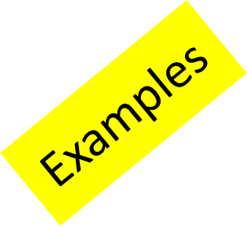
AUDIT AND CONTROLS TESTING
Verifies the adequacy and effectiveness of controls and ensures the capability to prove the completeness of data processing results:
Their validity would have been verified during design.
This would have been normally carried out as part of System Testing once the primary application functions have stabilized.
Inquiries of appropriate management, supervisor, and staff personnel
Inspection of documents, reports, and electronic files
Observation of the application of specific controls
Re-performance of the application of the control by the auditors

Slide 23
CONVERSION TESTING
It verifies the compatibility of the converted program, data, and procedures with those from existing systems that are being converted or replaced. Their validity would have been verified during design.
Most programs that are developed for conversion purposes are not totally new. They are often enhancements or replacements for old, deficient, or manual systems.
The conversion may involve files, databases, screens, report formats, and so on.
Conversion Testing is done whenever a project database is converted to a new version.
A two-method verification process is needed to complete this conversion.
The first method is to hire a database auditor to check value ranges and required relationships between records.
The second method is to randomly select a small subset of old records and compare against a subset of new records.
Notes:
Example: Conversion Testing is done whenever a project database is converted to a new version. The First verification method involves the use of a database auditor that must be built by the development group. When ran against the converted database, the database auditor will check value ranges within a record and the required relationships between records. The second verification method involves the random selection of a small subset of old records and then a direct comparison against a corresponding subset of the new records.

Slide 24
DOCUMENTATION AND PROCEDURES TESTING
Ensures that the interface between the system and the people works and is usable
Ideally, the persons who will use the documentation and procedures are the ones who should conduct these tests
Done as part of procedure testing to verify that the instruction guides are helpful and accurate
Documentation and Procedures testing
Not generally done until the externals of the system have stabilized
Both areas of testing are normally carried out late in the cycle as part of System Testing or in the UAT
Notes:
Example: Documentation is as important to a product’s success as the product itself. If the documentation is poor, non-existent, or wrong, it reflects on the quality of the product. Document testing includes any type of document verification—test case specification, test incident report, test log, test plan, test procedure, and test report.

Slide 25
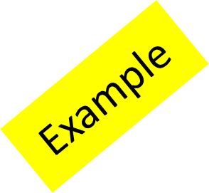
ERROR HANDLING TESTING
Error-handling is the system function for detecting and responding to exception conditions (such as erroneous input).
Error handling ensures that incorrect transactions will be properly processed and that the system will terminate in a controlled, and predictable way in case of a disastrous failure.
Error-Handling testing includes the handing of run time error like input of an invalid character.
Testing to confirm that application can recover from all types of error when they occur without terminating the application, or (if all else fails) gracefully terminate an affected application and save the error information to a log file.

Slide 26
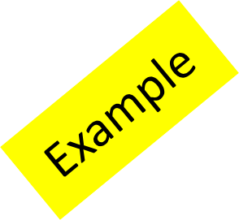
FUNCTIONS/REQUIREMENTS TESTING
Functional testing verifies, at each stage of development, that each business function operates as stated in the Requirements and as specified in the External and Internal Design documents.
Functional testing is usually completed in System Testing so that by the time the system is handed over to the user for UAT, the test group has already verified that the system meets requirements.
This type of testing ignores the internal parts and focus on the output, whether it is as per requirement or not.
Black-Box type testing is geared to functional requirements of an application.

Slide 27
INSTALLATION TESTING
Any application that will be installed and run in an environment remote from the development location requires installation testing.
This is especially true of network systems that may be run in many locations.
This is also the case with packages where changes were developed at the vendor's site.
This is necessary if the installation is complex, critical, should be completed in a short window, or of high volume, such as in microcomputer installations.
This type of testing should always be performed by those who will perform the installation process.
Tested for full, partial, or upgrade install / uninstall processes on different operating systems under different hardware, software environment so that no issue is faced by the end user while installing the application once the code is in production.

Slide 28
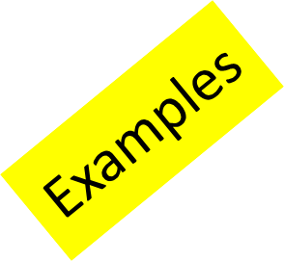
INTERFACE/INTER-SYSTEM TESTING
Ensures that the interconnections between applications function correctly.
Application systems often interface with other application systems. Most often, there are multiple applications involved in a single project implementation.
More complex if the applications operate on different platforms, in different locations , or use different languages.
Interface/Inter- system testing
Interface Testing is performed to evaluate whether systems or components pass data and control correctly to one another.
An inter-system test is the way you find out if the inter-system is working without any problem.
Notes:
Example: Interface Testing is performed to evaluate whether systems or components pass data and control correctly to one another. It is to verify if all the interactions between these modules are working properly and errors are handled properly.
An inter-system test, for example, could be a memory map, showing what is in memory at that moment. It basically is the way you find out if the inter-system is working without any problem, and is a big help when you do have a problem in finding a fix for it.

Slide 29

PARALLEL TESTING
Parallel testing compares the results of processing the same data in both the old and new systems.
Parallel testing is useful when a new application replaces an existing system, when the same transaction input is used in both, and when the output from both is reconcilable.
Parallel testing is useful when switching from a manual system to an automated system.
Ensures that the new version of the application performs correctly.
Ensures consistencies and inconsistencies are the same between the old and the new version.
Ensures the integrity of the new application.
Verifies if the data format between the two versions have changed.
Operating new and old version of a payroll system to determine that the paychecks from both systems are reconcilable.
Running old version of application to ensure that the functions of old system are working fine with respect to the problems encountered in the new system.
Notes:
Example: Parallel testing is a testing technique in which the same inputs are entered in two different versions of the application and reporting the anomalies.
▪ Ensures that the new version of the application performs correctly.
▪ Ensures consistencies and inconsistencies are the same between the old and the new version.
▪ Ensures the integrity of the new application.
▪ Verifies if the data format between the two versions have changed.
▪ Operating new and old version of a payroll system to determine that the paychecks from both systems are reconcilable. “Running old version of
application to Example: - ensure that the functions of old system are working fine with respect to the problems encountered in the new system.

Slide 30
SANITY VERSUS SMOKE TESTING
After receiving a software build, with minor changes in code or functionality, Sanity testing is performed to ascertain that the bugs have been fixed and no further issues are introduced due to these changes. The goal is to determine that the proposed functionality works roughly as expected. If sanity test fails, the build is rejected to save the time and costs involved in a more rigorous testing.
Sanity Testing
Smoke Testing is performed after software build to ascertain that the critical functionalities of the program is working fine. It is executed "before" any detailed functional or regression tests are executed on the software build. The purpose is to reject a badly broken application, so that the QA team does not waste time installing and testing the software application.
Smoke Testing

Slide 31
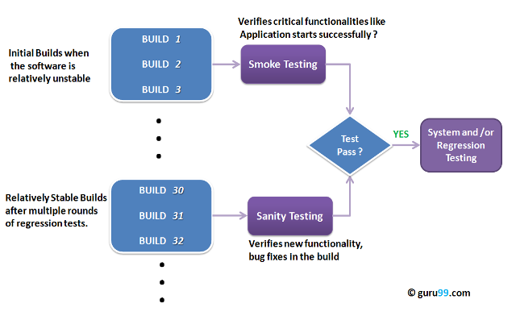
Smoke and Sanity Testing

Slide 32
Contd..
Smoke Testing
It is performed to ascertain that the critical functionalities of the program is working fine.
In Smoke Testing, the test cases chosen cover the most important functionality or component of the system.
It is executed "before" any detailed functional or regression tests are executed on the software build.
The objective is not to perform exhaustive testing, but to verify that the critical functionalities of the system is working fine.
For Example a typical smoke test would be – Verify that the application launches successfully, Check that the GUI is responsive ... etc.
Purpose is to reject a badly broken application, so that the QA team does not waste time installing and testing the software application.

Slide 33
Contd..
Sanity Testing
After receiving a software build, with minor changes in code, or functionality, Sanity testing is performed to ascertain that the bugs have been fixed and no further issues are introduced due to these changes.
The objective is "not" to verify thoroughly the new functionality, but to determine that the developer has applied some rationality (sanity) while producing the software. For instance, if your scientific calculator gives the result of 2 + 2 =5! Then, there is no point testing the advanced functionalities like sin 30 + cos 50.
The goal is to determine that the proposed functionality works roughly as expected.
If sanity test fails, the build is rejected to save the time and costs involved in a more rigorous testing.

Slide 34

REGRESSION TESTING
Verifies that no unwanted changes were introduced to one part of the system as a result of making changes to another part of the system.
It is assumed that several iterations of the system test will be done in order to test program modifications made during the system test period. A regression test will be performed for each new version of the system to detect unexpected impact resulting from program modifications.
The regression test will be done by running all of the tests on a new version that were run on the previous version and then comparing the resulting files.
C

Slide 35
TRANSACTION FLOW TESTING
Testing of the path of a transaction from the time it enters the system until it is completely processed and exits a suite of applications.
A transaction is a unit of work seen from a system user's point of view. It consists of a sequence of operations, some of which are performed by a system, persons or devices that are outside of the system.
The most common testing is used to test the request a retry after user input errors. An ATM system, for example, allows the user to try, say three times, and will take the card away the fourth time.
A
B
C
C

Slide 36
USABILITY TESTING
Ensures that the final product is usable in a practical, day-to-day fashion.
Looks for simplicity and user-friendliness of the product.
Would normally be performed as part of functional testing during System and User Acceptance Testing.
.
Usability Testing tests the following features of the software:
How easy it is to use the software
How easy it is to learn the software
How convenient is the software to end user
C

Slide 37
STRUCTURAL TESTING
Ensures that the technical and "housekeeping" functions of the system works
Designed to verify that the system is structurally sound and can perform the intended tasks
Categories:
Backup and Recovery testing
Contingency testing
Operational testing
Job Stream testing
Performance testing
Security testing
Stress/Volume testing

Slide 38
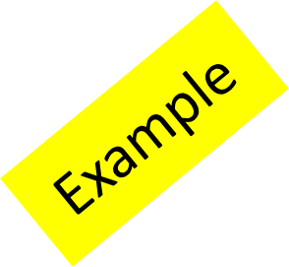
BACKUP AND RECOVERY TESTING
Recovery is the ability of an application to be restarted after failure.
The process usually involves backing up to a point in the processing cycle where the integrity of the system is assured and then re-processing the transactions past the original point of failure.
The nature of the application, the volume of transactions,
the internal design of the application to handle a restart process, the skill level of the people involved in the recovery procedures, documentation and tools provided, all impact the recovery process.
Backup and recovery will be tested by halting the machine during stand-alone time and then following the recovery procedures.

Slide 39

CONTINGENCY TESTING
Operational situations may occur which result in major outages or disasters.
Some applications are so crucial that special precautions need to be taken to minimize the effects of these situations and speed the recovery process. This is called contingency.
Risk server overload (denial of service): The online reservation system can handle only 500 users at one time, more than 500 users attempting to access the system may result in denial of service.
Mitigation Plan: An extra server to be maintained so that it could share the traffic with the main server.
Contingency Plan: On failure of the two servers to handle the load, route any new user to a third server showing a message for service not available.
C
C
Notes:
Example: The process of testing that the disaster recovery plans (also known as system contingency plans) and the associated business continuity plans work as specified.
Risk server overload (denial of service): The online reservation system can handle only 500 users at one time, more than 500 users attempting to access the system may result in denial of service.
Mitigation Plan: An extra server to be maintained so that it could share the traffic with the main server.
Contingency Plan: On failure of the two servers to handle the load, route any new user to a third server showing a message for service not available.

Slide 40
OPERATIONAL TESTING
Its operational characteristics are equally important as users expect and demand a guaranteed level of service from Computer Services.
All products delivered into production must obviously perform according to the user’s requirements.
However, a product's performance is not limited solely to its functional characteristics.
Even though operability testing is the final point where a system's operational behavior is tested, it is still the responsibility of the developers to consider and test operational factors during the construction phase.
Operational testing
Verifying file labeling and protection functions are working properly.
Determine a system can run using document
Notes:
Example: To verify that before application goes to production the operating procedures and staff can properly execute the application. Evaluation of process and execution of process.
▪ Verifying file labelling and protection functions are working properly.
▪ Determine system can run using document

Slide 41
JOB STREAM TESTING
Done as a part of operational testing (the test type not the test level, although this is still performed during operability testing):
Starts early and continues throughout all levels of testing
Conformance to standards is checked in user acceptance and operability testing
A
B
Payroll processing - a comprehensive set of records of salaried employees, hourly employees, and a merged set of these two should be used to test payroll processing.
Run each of the periodic reporting job streams at least once.
C
C
Notes:
In a non-interactive computer system, particularly IBM mainframes, a job stream, jobstream, or simply job is the sequence of job control language statements (JCL) and data (called instream data) that comprise a single "unit of work for an operating system".^{[1]} The term job traditionally means a one-off piece of work, and is contrasted with a batch(executing the same steps over many inputs), but non-interactive computation has come to be called "batch processing", and thus a unit of batch processing is often called a job, or by the oxymoronic term batch job; see job for details. Performing a job consists of executing one or more programs. Each program execution, called a job step, jobstep, orstep, is usually related in some way to the others in the job. Steps in a job are executed sequentially, possibly depending on the results of previous steps, particularly in batch processing.
The term "job stream" is particularly associated with mainframes; in the IBM z/OS operating system, a job is initiated by a // JOB and terminated by the next // JOB or //statement. Each job step consists of one // EXEC statement indicating the program to be executed and usually multiple // DD statements defining the files and devices to be used.
Example[edit]
A simple example of a job stream is a system to print payroll checks which might consist of the following steps, performed on a batch of inputs:
Read a file of data containing employee id numbers and hours worked for the current pay period (batch of input data). Validate the data to check that the employee numbers are valid and that the hours worked are reasonable.
Compute salary and deductions for the current pay period based on hours input and pay rate and deductions from the employee's master record. Update the employee master "year-to-date" figures and create a file of records containing information to be used in the following steps.
Print payroll checks using the data created in the previous step.
Update bank account balance to reflect check numbers and amounts written.
Each step depends on successful completion of the previous step. For example, if incorrect data is input to the first step the job might terminate without executing the subsequent steps to allow the payroll department to correct the data and rerun the edit. If there are no errors the job will run to completion with no manual intervention.

Slide 42
JOB STREAM TESTING
A simple example of a job stream is a system to print payroll checks which might consist of the following steps, performed on a batch of inputs:
Read a file of data containing employee id numbers and hours worked for the current pay period (batch of input data). Validate the data to check that the employee numbers are valid and that the hours worked are reasonable.
Compute salary and deductions for the current pay period based on hours input and pay rate and deductions from the employee's master record. Update the employee master "year-to-date" figures and create a file of records containing information to be used in the following steps.
Print payroll checks using the data created in the previous step.
A
B
C
C
Notes:
In a non-interactive computer system, particularly IBM mainframes, a job stream, jobstream, or simply job is the sequence of job control language statements (JCL) and data (called instream data) that comprise a single "unit of work for an operating system".^{[1]} The term job traditionally means a one-off piece of work, and is contrasted with a batch(executing the same steps over many inputs), but non-interactive computation has come to be called "batch processing", and thus a unit of batch processing is often called a job, or by the oxymoronic term batch job; see job for details. Performing a job consists of executing one or more programs. Each program execution, called a job step, jobstep, orstep, is usually related in some way to the others in the job. Steps in a job are executed sequentially, possibly depending on the results of previous steps, particularly in batch processing.
The term "job stream" is particularly associated with mainframes; in the IBM z/OS operating system, a job is initiated by a // JOB and terminated by the next // JOB or //statement. Each job step consists of one // EXEC statement indicating the program to be executed and usually multiple // DD statements defining the files and devices to be used.
Example[edit]
A simple example of a job stream is a system to print payroll checks which might consist of the following steps, performed on a batch of inputs:
Read a file of data containing employee id numbers and hours worked for the current pay period (batch of input data). Validate the data to check that the employee numbers are valid and that the hours worked are reasonable.
Compute salary and deductions for the current pay period based on hours input and pay rate and deductions from the employee's master record. Update the employee master "year-to-date" figures and create a file of records containing information to be used in the following steps.
Print payroll checks using the data created in the previous step.
Update bank account balance to reflect check numbers and amounts written.
Each step depends on successful completion of the previous step. For example, if incorrect data is input to the first step the job might terminate without executing the subsequent steps to allow the payroll department to correct the data and rerun the edit. If there are no errors the job will run to completion with no manual intervention.

Slide 43
JOB STREAM TESTING
Update bank account balance to reflect check numbers and amounts written.
Each step depends on successful completion of the previous step. For example, if incorrect data is input to the first step the job might terminate without executing the subsequent steps to allow the payroll department to correct the data and rerun the edit. If there are no errors the job will run to completion with no manual intervention.
A
B
C
C
Notes:
In a non-interactive computer system, particularly IBM mainframes, a job stream, jobstream, or simply job is the sequence of job control language statements (JCL) and data (called instream data) that comprise a single "unit of work for an operating system".^{[1]} The term job traditionally means a one-off piece of work, and is contrasted with a batch(executing the same steps over many inputs), but non-interactive computation has come to be called "batch processing", and thus a unit of batch processing is often called a job, or by the oxymoronic term batch job; see job for details. Performing a job consists of executing one or more programs. Each program execution, called a job step, jobstep, orstep, is usually related in some way to the others in the job. Steps in a job are executed sequentially, possibly depending on the results of previous steps, particularly in batch processing.
The term "job stream" is particularly associated with mainframes; in the IBM z/OS operating system, a job is initiated by a // JOB and terminated by the next // JOB or //statement. Each job step consists of one // EXEC statement indicating the program to be executed and usually multiple // DD statements defining the files and devices to be used.
Example[edit]
A simple example of a job stream is a system to print payroll checks which might consist of the following steps, performed on a batch of inputs:
Read a file of data containing employee id numbers and hours worked for the current pay period (batch of input data). Validate the data to check that the employee numbers are valid and that the hours worked are reasonable.
Compute salary and deductions for the current pay period based on hours input and pay rate and deductions from the employee's master record. Update the employee master "year-to-date" figures and create a file of records containing information to be used in the following steps.
Print payroll checks using the data created in the previous step.
Update bank account balance to reflect check numbers and amounts written.
Each step depends on successful completion of the previous step. For example, if incorrect data is input to the first step the job might terminate without executing the subsequent steps to allow the payroll department to correct the data and rerun the edit. If there are no errors the job will run to completion with no manual intervention.

Slide 44
PERFORMANCE TESTING
Performance testing is designed to test whether the system meets the desired level of performance in a production environment. Performance considerations may relate to response times, turn around times (through-put), technical design issues, and so on.
Performance testing can be conducted using a production system, a simulated environment, or a prototype.
Performance will be evaluated against the performance requirements by measuring the run times of several jobs using production data volumes.

Slide 45
SECURITY TESTING
Security of an application system is required to ensure the protection of confidential information in a system and in other affected systems is protected against loss, corruption, or misuse; either by deliberate or accidental actions.
The amount of testing needed depends on the risk assessment of the consequences of a breach in security. Tests should focus on, and be limited to those security features developed as part of the system.
Attempted access without a proper password to the on-line data entry and display transactions (notification to the user of invalid authentication) will be tested.
Notes:
Example: Attempted access without a proper password to the on-line data entry and display transactions (notification to the user of invalid authentication) will be tested.
Can system be penetrated by any hacking way? Test how well the system protects against unauthorized internal or external access. Check if system database is safe from external attacks.

Slide 46
STRESS/VOLUME TESTING
Defined as the processing of a large number of transactions through the system in a defined period of time. Done to measure the performance characteristics of the system under peak load conditions.
Stress factors may apply to different aspects of the system, such as input transactions, report lines, internal tables, communications, computer processing capacity, throughput, disk space, I/O, and so on.
Should not begin until the system functions are fully tested and stable. The need for Stress Testing must be identified in the Design Phase and should commence as soon as operationally stable system units are available.
B
C
System is stressed beyond its specifications to check how and when it fails. Performed under heavy load like putting large number beyond storage capacity, complex database queries, and continuous input to system or database load.
C

Slide 47
TOP-DOWN TESTING
In this approach, testing is conducted from main module to sub module. If the sub module is not developed, a temporary program called Stub is used for simulate the sub module.
Advantages:
Top-down testing is advantageous if major flaws occur toward the top of the program
Once the I/O functions are added, representation of test cases is easier
Early skeletal program allows demonstrations and boosts morale
Disadvantages:
Stub modules must be produced
Stub modules are often more complicated than they first appear to be
Before the I/O functions are added, representation of test cases in stubs can be difficult
Test conditions may be impossible, or very difficult, to create
Observation of test output is more difficult
Top-down testing allows one to think that design and testing can be overlapped
Top-down testing induces one to defer completion of the testing of certain modules

Slide 48
BOTTOM-UP TESTING
Approach to integration testing where the lowest level components are tested first and then used to facilitate the testing of higher level components.
This process is repeated until the component at the top of the hierarchy is tested.
In this approach, testing is conducted from sub module to main module; if the main module is not developed, a temporary program called Drivers is used to simulate the main module.
Advantages:
It is advantageous if major flaws occur toward
the bottom of the program.
Test conditions are easier to create.
Observation of test results is easier.
A
B
Disadvantages:
Driver Modules must be produced.
The program as an entity does not exist until the last module is added.
C
C

Slide 49
ACTIVITY
Identify what type or kind of testing should be used in the following situations.
A banking institution has just bought an new software that would make their products and services better and available to its clients. One of the features that they emphasized important is the safety of the client data/information.
Which do you think should be the best type of testing to be performed in order to achieve the company's goal?
Load Testing
Stress Testing
Security Testing
Operational Testing
Contingency Testing
C
C
Notes:
Identify what type or kind of testing should be used in the following situations provided by the instructor:
▪ Is the example given / provided require Functional or Structural testing?
The correct answer is C. Security Testing

Slide 50
QUIZ QUESTION
What are the two types of testing?
Static and Dynamic testing
Dynamic and Reviews testing
State Transition testing
Reviews and Inspection
Notes:
Answer: Static and Dynamic Testing.

Slide 51
QUIZ QUESTION
Which of the following is a purpose for Regression testing?
To check that new functionality has been added or not
To check that the existing functionality has been changed
To check that no unwanted changes were introduced to one part of the system as a result of making changes to another part of the system
To check the product is working well after the changes has been made
Notes:
Answer:- To check That no unwanted changes were introduced to one part of the system as a result of making changes to another part of the system.

Slide 52
QUIZ QUESTION
Which one of these is not a part of Static Testing?
Inspections
Reviews
Walkthroughs
White Box testing and Black Box testing
Notes:
Answer: White box testing and Black Box Testing.

Slide 53
Static Testing Techniques

Slide 54

WHAT ARE REVIEWS AND INSPECTIONS?
Reviews and Inspections: Verifying or checking for correctness
Defined as:
Activities involved in verifying a product against specified requirements
The process of identifying defects in the work product
It is:
A methodical examination of software work products
Done over both executable and non-executable software work products
Helpful in identifying defects and areas where changes are needed
Considered a best industry practice for use on software projects
Notes:
A methodical examination of software work products: Reviews and Inspections is a methodical examination of software work products generated at different phases of software development life cycle or modified during maintenance (for example, code change for a bug in an existing software).

Slide 55
WHY USE REVIEWS AND INSPECTIONS?
Improve the software product and increase customer satisfaction
Enable mid- course or timely corrections
Detect defects early in a project
A
B
Reviews and Inspections
Ensure correctness and ensure correctness regarding requirements
Ensure adherence to the
standards
Ensure
consistency
C
C
Notes:
Why?
It helps to:
• Detect defects early in a project so as to enable mid-course or timely corrections.
• Ensure correctness and consistency with respect to requirements, thus improving the software product and increasing customer satisfaction.
• Ensure adherence to the standards (set by IBM or customer).

Slide 56
WHEN TO CONDUCT REVIEWS AND INSPECTIONS PROCESS?
Effective reviews will help detect errors as soon as they are made so that it saves time and effort.
A
B
The process need to be done throughout project execution from start to finish.
C

Slide 57
HOW TO CONDUCT REVIEWS AND INSPECTIONS PROCESS?
There are several methods in conducting reviews and inspections:
Peer Review
Formal Inspections

Slide 58

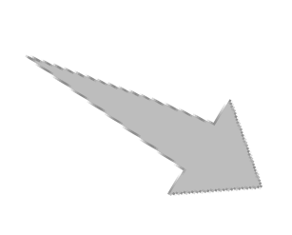


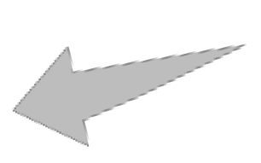
GENERAL REVIEW PROCESS
1
Planning
2
5
Preparation
Follow-up
4
3
C
Review
Rework
C

Slide 59
ENTRY AND EXIT CRITERIA FOR A REVIEW PROCESS
Decision made Product acceptance (As is or after minor changes) Product rejection (repeat review)
New or Revised product is to be reviewed
Review Process

Slide 60


TOM’S STORY: SETTING UP THE CHRISTMAS TREE (1 OF 6)
Tom and his wife Pam are busy preparing for Christmas. They decide that Tom would buy and set up the Christmas tree, while Pam is out shopping for the gifts.

Slide 61

TOM’S STORY: SETTING UP THE CHRISTMAS TREE (2 OF 6)
Tom, so you’ll buy a large Christmas tree and start setting up the star and lights along with the tree? I think we will need an extension cord for the lights as well.
A
B
C
C

Slide 62

TOM’S STORY: SETTING UP THE CHRISTMAS TREE (3 OF 6)
Sure. Will do.
A
B
C
C

Slide 63
TOM’S STORY: SETTING UP THE CHRISTMAS TREE (4 OF 6)
Once done with my shopping, I’ll help you finish the decorations before evening. The kids will be delighted to see it when they’re back home!
A
B
C
C

Slide 64
TOM’S STORY: SETTING UP THE CHRISTMAS TREE (5 OF 6)
Ok! Sounds like a plan!
A
B
C
C

Slide 65

TOM’S STORY: SETTING UP THE CHRISTMAS TREE (6 OF 6)
By evening, Tom has assembled the tree, and is almost done putting up the star and the lights when his wife and kids walk in.
They are happy to see the tree, but Pam says “I really wanted to see a golden star and not a silver star”.
Tom then switches on the lights but they are not working. Since the lights are already on the tree, he gets a ladder and checks them one by one to make sure they are ok.
He then finally has to remove the extension cord to check it, and he realizes there is a problem with the extension cord.
Pam tries to place a gift near the base of the tree when she notices a crack on the stand at the base of the tree that is holding it up. No sooner than she points it out that
A
B
C
C
Notes:
So what were the lessons learned?
Lessons:
▪ Had Tom checked the parts of the fake tree before assembling it and also the extension cord before connecting it, it would have saved him a lot of time and effort. Even then, he would still have to travel all the way back to the store to get it replaced (wasted time).
▪ Had Tom checked the parts of the fake tree, the lights, and the extension cord right at the store, he would have saved even more time and effort.

Slide 66
LEARNING'S FROM TOM’S STORY
Early checking of the parts of the fake tree and the extension cord would have saved a lot of time and effort.
Checking the items right at the store would have saved even more time and effort.
A
B
C
C

Slide 67
TRANSLATING THE REAL WORLD SCENARIO INTO PROJECT
The assembling of the Christmas tree is similar to a software project.
Reviews are required to ensure that IBM’s understanding matches with the client’s specifications.
The code is developed inline with the design which, in turn, is produced inline with the requirements gathered.
If the requirements are gathered wrong, the defect is passed on to the design, and if there is an error in the design, it is also reflected in the code.
In fact, defective parts, when assembled, do not function as a whole and a great deal of effort is wasted on detecting the source of the defect.
Thus, we see the importance of reviews.
Notes:
The assembling of the Christmas tree is similar to a software project. Pam giving directions to Tom is similar to a client specifying his requirements to IBM. Pam is unhappy that Tom bought a silver star instead of a gold one.
▪ Similarly, when clients specify requirements, reviews are required to ensure that IBM’s understanding matches with the client’s specifications.
▪ The different tree parts, lights, and extension cord are similar to different blocks of code that developers might produce. The code is developed in line with the design which in turn is produced in line with the requirements gathered.
▪ If the requirements are gathered wrong, the defect is passed on to the design, and if there is an error in the design, it is also reflected in the code. So when the code is tested, desired results are not achieved.
▪ In fact, defective parts, when assembled, do not function as a whole, and a great deal of effort is wasted on detecting the source of the defect, that is, is it a defect in the code or a defect in the design or a defect in the requirements gathered?
▪ Thus, we see the importance of reviews and also the importance of detecting errors as soon as they are made.

Slide 68
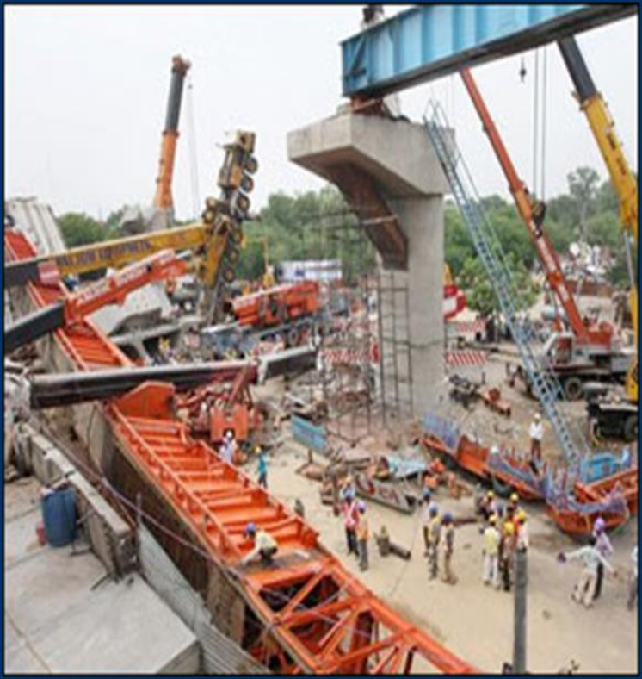
THE DELHI METRO MISHAP
Lack of proper inspection caused a major mishap at Delhi Metro rail site. The committee found out that there was a deficiency in the design of the cantilever arm and that the concrete did not have adequate strength due to lack of its adequate curing.
Six persons were killed when an under- construction over-bridge of Delhi Metro collapsed in Zamarudpur area of South Delhi.
B

Slide 69

THE DELHI METRO MISHAP
Contributing factors to this incident:
Lack of supervision
Compromising on the quality
Bypassing the inspection process
Notes:
▪ The main reason of such accidents is lack of supervision, which leads to poor quality construction.
▪ There are certain operating procedures which have to be followed at every step of construction and inspection. As these types of projects depend upon team work, it is the moral duty of everyone, either director or laborer, to not compromise on the quality and bypass inspection process.
▪ Since Gammon and DMRC had bypassed certain checks and inspection processes, this disaster occurred.

Slide 70
MYTHS ABOUT REVIEWS AND INSPECTIONS
Myth | Reality
Reviews and inspections require a lot of extra effort, and thus increase the cost of a project. | If reviews are done in a timely manner and by members who are well-versed with the product being reviewed, it requires minimal effort.
Hard work alone results in quality. Everyone always tries to produce high quality. | Even if everyone genuinely works hard to produce high quality products, manual error is always possible.
Reviews and inspections can be done only by senior staff. | Anyone who is well-versed about the product being reviewed can do the reviews.
A
B
C
C
Notes:
Reality:
▪ If reviews are done in a timely manner and by members who are well-versed with the product being reviewed, it requires minimal effort. No reviews result in defects and rework taking even more time and effort to make fixes.
▪ Even if everyone genuinely works hard to produce high quality products, manual error is always possible. Also, it is easy to miss defects when we continuously look at the same piece of code. A peer might be able to catch it easily.
▪ Anyone who is well-versed about the product being reviewed can do the reviews.

Slide 71
QUIZ QUESTION
Reviews and inspections are done for:
Executable software work products
Non-executable software work products
Released software products
Notes:
Answer: Executable software work products and Non-Executable software work product.

Slide 72
QUIZ QUESTION
Why are reviews done?
To detect and correct defects
To be consistent with customer requirements
To adherence to standards
To accommodate new requirements
To measure contribution of each team member
Notes:
Answer:- To Adherence to Standards.

Slide 73
QUIZ QUESTION
Which of the following is true about reviews?
Reviews increase the cost of a project since it requires a lot of extra effort.
A hardworking and sincere team does not require reviews.
Reviews are one of the best industry practices.
Reviews can only be done by senior staff.
Notes:
Answer: Reviews are one of the best industry Practices.

Slide 74
TYPES OF REVIEWS
There are various types of reviews that are based on different factors as given below.
Method of review
Peer or buddy reviews
Facilitation reviews or inspections
Requirement review
Design review
Code review
Test Results review
Product reviewed
Process reviews
Project Management reviews
Critical Thread reviews
Purpose
Notes:
There are many types of reviews based on different factors. A few are mentioned here:
Based on method of review:
• Peer or buddy reviews
• Facilitation reviews or inspections
Based on product reviewed:
• Requirement review
• Design review
• Code review
• Test Results review
Based on purpose:
• Process reviews (to check compliance to organization processes)
• Project Management Reviews (to review project health and check risks)
• Critical Thread Reviews (meetings to discuss and review topics on people, process, and performance)

Slide 75
PEER REVIEWS VERSUS FACILITATOR REVIEWS
Peer reviews
Informal review to confirm the understanding of the producer
and check for correctness of
product
One or more peer members perform the review either jointly or independently
Facilitator reviews
Formal review to verify that the artifact complies with the standard of excellence
5-10 participants in the review
that is led by a review leader
Notes:
Peer reviews
o Peer or buddy reviews (walkthroughs) are informal reviews used to confirm the understanding of the producer and check for correctness of product being reviewed.
o One or more peer members (with expertise in the subject of the product to be reviewed) perform the review either jointly or independently.
▪ Facilitator Reviews
o Facilitator reviews (inspection) are formal reviews used to verify that the artifact compiles with the standard of excellence.
o A team of not less than 5 percent and not more than 10 (each with specific defined roles) participates in the review that is led by a review leader.

Slide 76
FACTORS TO DECIDE WHICH TYPE OF REVIEWS TO USE
Work product type
Business criticality
Work product complexity

Slide 77
PEER REVIEWS: CHARACTERISTICS
This is a less formal verification technique.
It is the author who initiates the session.
There may be several peer reviews in each software development lifecycle activity.
Notes:
Peer reviews:
▪ This is a less formal verification technique - This is a less formal verification technique in which a technical peer analyzes or improves the quality of the original work product, for example, by finding defects or proposing a more optimal solution.
▪ It is the author who initiates the session - Since peer reviews cater to the needs of the producer or author of the software artifact (in acquiring superior knowledge of all aspects of it), it is the author who initiates the session.
▪ There may be several peer reviews in each software development life cycle activity - There may be several peer reviews in each software development life cycle activity and they yield open issues and action items. While these issues and action items may be tracked to closure, the only measurement taken from these reviews is a count of the number of peer reviews held along with effort spent and process improvements identified.

Slide 78
EXPECTED END RESULTS OF PEER REVIEWS
Participants - reviewer(s) and author - agree on the approaches taken, product, and engineering practices applied.
Completeness and correctness of capabilities and features of the reviewed product are obtained.

Slide 79
FACILITATION REVIEWS: ROLES AND RESPONSIBILITIES
Product Owner
(Author)
Roles involved in a peer review
SQA (Software Quality Analyst)
Reviewers

Slide 80
PEER REVIEW: ROLES AND RESPONSIBILITIES
Product Owner (Author):
Initiates and schedules reviews
Ensures adherence to review process
Identifies reviewers and distributes the product
Ensures rework is carried out
Reviewers:
Documents the review findings and completes the “Review Summary Report”
Reviews the product
Can also approve the product
SQA (Software Quality Analyst):
Reviews the product and communicates the comments to the review leader
Tracks the rework and resolution list to closure
Signs off the review summary report
Notes:
Product Owner (Author):
▪ Initiating the review process and scheduling reviews
▪ Ensuring the review process is adhered to
▪ Identifying reviewers and distributing the product for review. The owner may seek help from his manager in identification.
▪ Ensuring any rework as a result of the review is carried out
▪ Filing the quality records that are generated during the review process as objective evidence of having carried out the review
Reviewers:
▪ Documenting the review findings and completing the ‘Review Summary Report’
▪ Reviewing the product
▪ Can also approve the product
SQA (Software Quality Analyst):
▪ Where applicable, reviewing the product and communicating the comments to the review leader
▪ Where applicable, tracking the rework and resolution list to closure
▪ Signing off the review summary report after ensuring the defect / resolutions list is closed and the summary report is complete

Slide 81
PEER REVIEW PROCEDURE
1
2
The reviewer goes through the product or document and identifies defects.
3
The Project Manager (PM) or Project Lead (PL) identifies the reviewer.
The reviewer discusses the defects or improvements identified and takes corrective action required.
Agreed upon defects or improvements are documented in Work Product Inspection (WPI) form.
4
The reviewer checks closure of all defects or comments.
5
6
The author takes up correction of all the defects and informs the readiness of the product or the document to the reviewer.
Notes:
•The Project Manager (PM) or Project Lead (PL) identifies the reviewer based on the size, complexity, and importance of the product or document to be reviewed.
•The reviewer goes through the product or document and identifies defects based on appropriate checklists or specifications or standards.
•The reviewer discusses the defects or improvements identified, the corrective action required, and provides clarifications if any.
•Once the defects or improvements are agreed upon, they are documented in the Work Product Inspection (WPI) form. It is the
responsibility of the PM or PL to ensure that the reviews are conducted, results documented, and the defect corrections are carried out.
•The author takes up the correction of all the defects identified to be corrected and informs the readiness of the product or the document to the reviewer.
•If re-review is required, another iteration of review is done, but if the review result requires only verification of the closure of defects or comments, the reviewer checks whether all defects have been closed.

Slide 82



PEER REVIEW: ROLES AND RESPONSIBILITIES
John is a Project Lead handling Project A. Lisa and Tom are working on modules 1 and 2 respectively, and have just completed the testing of their modules.

Slide 83


PROJECT A - PEER REVIEW
Hi Lisa and Tom. Now that you have completed testing your modules, you can peer review each test cases. As peers who have worked on the project design, both of you are aware of the functionality of both the modules. Hence, the reviews will be effective.

Slide 84


PROJECT A - PEER REVIEW
Sure John. I have not done such reviews earlier. Are there any guidelines that can help me to do the review better?

Slide 85
PROJECT A - PEER REVIEW
Yes. You can find the testing review checklist in our Asset Library. You can use that for effective review.

Slide 86
PROJECT A - PEER REVIEW
Ok John. We will peer review each others test case designs and also ensure that defects, if any, are closed.

Slide 87
SIMPLE PRACTICAL WAY FOR TESTING AND DEBUGGING
Start
Design a set of test cases
Check the test cases
Do static testing based on test cases
Do dynamic testing based on test cases
Analyze the data during debugging
End

Slide 88

PEER REVIEW SCENARIO
Based on the scenario on Lisa and Tom's peer review, there are two things that came up (if we look at the test case closely):
Spelling of “Error” in error message is wrong.
Error message has been copy-pasted. Second error message needs to be changed.

Slide 89
REVIEW OF TEST CASES EXAMPLE
A tester has to test for a function as: Function to send order by Email
Fields
Email ID
Recipients name
Click Button
Send
Test case
Enter the Email ID of person
Enter the recipient name
Click on Submit button

Slide 90
REVIEW OF TEST CASES EXAMPLE
Test Suite ID - TC001
Test Case ID - TCHome_01
Test Case Summary - To send an email to recipient on the order placed
Related Requirement - NA
Prerequisites - Order should be placed
Steps to execute - Enter Email id, Enter recipient name, and click Submit
Test Data - The test data, or links to the test data, that are to be used while conducting the test
Expected Result - The email is sent
Actual Result - The actual result of the test; to be filled after executing the test

Slide 91
REVIEW OF TEST CASES EXAMPLE
Status - Pass or Fail. Other statuses can be ‘Not Executed’ if testing is not performed and ‘Blocked’ if testing is blocked
Remarks - Any comments on the test case or test execution
Created By - The name of the author of the test case
Date of Creation - The date of creation of the test case
Executed By - The name of the person who executed the test
Date of Execution - The date of execution of the test
Test Environment - The environment (Hardware/Software/Network) in which the test was execute

Slide 92
REVIEW COMMENTS
Spelling Recipient is not correct in the test case summary and steps to test.
Expected result should always be having “Should” added - like - “Email should be sent to recipient.”

Slide 93
OVERVIEW OF FACILITATION REVIEWS
Facilitation Reviews or Inspections are the most rigorous form of reviews which involve structured formal reviews.
In a lifecycle activity, the software inspection is the exit criteria.
Notes:
▪ Facilitation Reviews or Inspections (also called Fagan’s Review) are the most rigorous form of reviews which involve structured formal reviews done by a group of technical personnel who analyze or improve the quality of the original work product as well as the quality of the method.
▪ In a lifecycle activity, the software inspection is the exit criteria or gate that concludes the activity.

Slide 94
CHARACTERISTICS OF FACILITATION REVIEWS
Consists of structured, well- defined processes with well-defined Roles.
Done by technical people for technical people
Reviewers prepared in advance; clarifications obtained before the meeting
Facilitation review characteristics
Review data recorded and used for monitoring effectiveness of the review procedure
Focus on identifying problems and not resolving them
Notes:
Characteristics of Facilitation reviews
• They are done by technical people for technical people.
• They consist of structured, well defined processes with well-defined roles for participants.
• Reviewers are prepared in advance, and clarifications are obtained before the meeting.
• Focus is on identifying problems and not resolving them.
• Review data from these reviews is recorded and used for monitoring effectiveness of the review procedure.

Slide 95
FAGAN`S INSPECTION/REVIEW
Structured process of trying to find defects in development.
Testing documents such as programming code, specifications, designs and others during various phases of the software development process.
Named after Michael Fagan who is credited with being the inventor of formal software inspections.
Examples of activities for which Fagan Inspection can be used are:
Requirement specification
Software/Information System architecture (for example DYA)
Programming (for iterations in XP or DSDM)
Software testing (when creating test scripts)

Slide 96
FACILITATION REVIEWS: ROLES AND RESPONSIBILITIES
Author or Producer
Product Owner
Recorder
Roles involved in a facilitation review
Review Leader or Inspection Leader (Moderator)
Reader
Reviewers or Inspectors

Slide 97
FACILITATION REVIEWS: ROLES AND RESPONSIBILITIES
Author/Producer
Distributes material to be reviewed
Provides overview on product
Provides clarifications as required
Participates as an inspector
Should not get defensive on an identified defect
Product Owner
Initiates the review process
Identifies a review leader
Assesses the readiness for review of the work-product
Identifies the reviewers and distributes the product for review
Ensures rework is carried out
Files the review records
Notes:
Author / Producer:
• Distributes material to be reviewed
• Provides overview on product
• Provides clarifications as required
• Participates as an inspector
• Should not get defensive on an identified defect
Product Owner:
• Initiates the review process
• Identifies a review leader; may seek help from his manager in identifying a review leader
• Assesses the readiness for review of the work-product along with the review leader
• Identifies the reviewers and distributes the product for review along with the review leader
• Ensures that any rework as a result of the review is carried out
• Files the review records that are generated during the review process as objective evidence of having carried out the review
• Review Leader / Inspection Leader (Moderator):
• Manages the entire process and ensures that the review process is adhered to
• Should be skilled in the area of leadership and communication, and be impartial
• Identifies the reviewers and assigns their roles, distributes the product and related documents
• Ensures preparedness before the review
• Controls the pace of review meetings, moderates the review, and also generates and distributes review forms or reports
• Participates as an inspector
• Takes responsibility for follow-up of rework and completion of the ‘Review Summary Report’
• Ensures that entry and exit criteria of the review process are met

Slide 98
FACILITATION REVIEWS: ROLES AND RESPONSIBILITIES
Reader:
Understands the material being reviewed
Paraphrases while reading
Sets the pace of inspection
Participates as an inspector
Reviewers/Inspectors:
Review the product and communicate the comments to the review leader
Identify one of the reviewers to consolidate the comments in the absence of the recorder
At least one inspector (apart from the author) should be an expert on the product being reviewed
Notes:
Reviewers / Inspectors:
▪ Review the product and communicate the comments to the review leader in the review meeting. This involves:
o Preparing for the inspection meeting
o Understanding the product
o Doing the inspection
o Focusing on product and NOT the producer
▪ In the absence of the recorder, the review leader is responsible for identifying one of the reviewers to consolidate the comments.
▪ Everybody involved in the facilitation review (leader, reader, recorded, and author) is an inspector, but it is important that at least one inspector (apart from the author) should be an expert on the product being reviewed.
Reader:
▪ Understands the material being reviewed
▪ Paraphrases while reading
▪ Sets the pace of inspection
▪ Participates as an inspector
Recorder:
▪ Records all review comments made at the meeting (as indicated by leader)
▪ Classifies errors
▪ Takes confirmation on each recorded error
▪ Participates as an inspector

Slide 99
FACILITATION REVIEWS: ROLES AND RESPONSIBILITIES
Review Leader/Inspection Leader (Moderator)
Manages the entire process
Should be skilled in the area of leadership and communication
Identifies the reviewers, assigns their roles, and distributes the product
Ensures preparedness
Controls the review process, generates and distributes review forms or reports
Participates as an inspector
Takes responsibility for follow-up of rework and completion of the “Review Summary Report”
Ensures that entry and exit criteria of the review process are met
Recorder:
Records all review comments made at the meeting
Classifies errors
Takes confirmation on each recorded error
Participates as an inspector

Slide 100

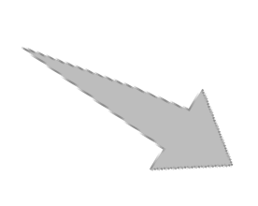



FACILITATION REVIEW PROCESS
1
Planning
6
Verify
2
Orientation
5
Rework
Preparation
3
C
Review Meeting
4
Notes:
Planning: Choose team, materials, and dates
▪ Orientation: Present product, process and goals (Kick-off)
▪ Preparation: Check product, and note issues
▪ Review Meeting: Consolidate issues
▪ Rework: Correct defects
▪ Verify: Verify product / process quality (Follow-up)

Slide 101




PROJECT A - FACILITATION REVIEW
Mike is the Manager of Project A. John is the Project Leader for the same project and reports to Mike. There are several team members, two of whom are Tom and Lisa. The clients have just specified their requirements to the onsite coordinator Jason. In their weekly meeting, the following discussion ensues:
Notes:
The clients have just specified their requirement to the onsite coordinator, Jason. After which, he went to the site to meet up with the team to discuss it, to ensure that everything as expected is covered and nothing gets missed out.

Slide 102
PROJECT A - FACILITATION REVIEW
I have captured the requirements specified by our clients.
Tom
John
Lisa
Jason
Mike

Slide 103
PROJECT A - FACILITATION REVIEW
That is good. We now need to ensure that they are reviewed and approved by the client. This is a huge project worth $1million. Hence, we need to be sure that we have captured the client requirements accurately.
Tom
John
Lisa
Jason
Mike

Slide 104
PROJECT A - FACILITATION REVIEW
Sure.
Tom
John
Lisa
Jason
Mike

Slide 105
PROJECT A - FACILITATION REVIEW
Jason, I want you to arrange a facilitation review and John can be the Review Leader. The clients, two of the senior team members, Tom and Lisa and, of course you, can take part in the review.
Tom
John
Lisa
Jason
Mike

Slide 106
PROJECT A - FACILITATION REVIEW
Sure. I will make arrangements for the review. I will send out the invitation for the meeting, based on everyone’s convenience and also after ensuring that all the reviewers get enough time for preparation. Tom, you can be the recorder and Lisa, you can be the reader.
Tom
John
Lisa
Jason
Mike

Slide 107
PROJECT A - FACILITATION REVIEW
Tom
John
Lisa
Jason
Mike
Sure. But I was just wondering, John, why aren’t you just doing a peer review of the requirements document?

Slide 108
PROJECT A - FACILITATION REVIEW
Tom
Well, it’s a huge project Lisa and the stakes are very high. Any issues with the requirements can translate into huge problems and even loss of business. Hence, we cannot take the risk. We will need a formal review with the clients.
John
Lisa
Jason
Mike

Slide 109
PROJECT A - FACILITATION REVIEW
Tom
John
Lisa
Jason
Mike
I see. Thanks for the clarification.

Slide 110
PROJECT A - FACILITATION REVIEW
Tom
Tom, you should use the work product inspection form from our Asset Library to record all the information with respect to the review. Make sure you capture all details.
John
Lisa
Jason
Mike

Slide 111
PROJECT A - FACILITATION REVIEW
Tom
John
Lisa
Jason
Mike
Sure John.

Slide 112
PROJECT A - FACILITATION REVIEW
Great. So we have a good plan now!
Tom
John
Lisa
Jason
Mike

Slide 113
FACILITATION REVIEW AND PEER REVIEW: COMPARISON
Review Characteristics | Fagan's Review/Inspection | Peer review
Role of review leader | Required | Not required
Role of recorder | Required | Not required
Number of reviewers | >= 5 and <=10 (including the review leader) | >= 1
Advance distribution of review material (product to be reviewed and related documentation) | Required (at least 2 days in advance of review meeting) | Required (at least 2 days in advance of when the comments are due)
Formal review meeting | Required | Not required
Review moderation | Done by review leader | Done by product owner (in case multiple reviewers are used and a meeting is held)
Consolidation of review comments | Done by recorder | Done by product owner
C

Slide 114
FACILITATION REVIEW AND PEER REVIEW: COMPARISON
Review Characteristics | Fagan's Review/Inspection | Peer review
Recording of review comments | Review defects/Resolution list must be used. (WPI Form) | Not required. (Number of reviews, review effort, and number of process improvements identified are recorded.)
Review summary report | Required, prepared by review leader | Required, prepared by product owner
Evidence of closure of review comments | Review leader verifies closure and signs on the review summary report | Product owner completes the review summary report with all details after review closure
Capturing review preparation time on review summary report | Required | Not required
Capturing review time on review summary report | Required | Required
A
B
C
C

Slide 115
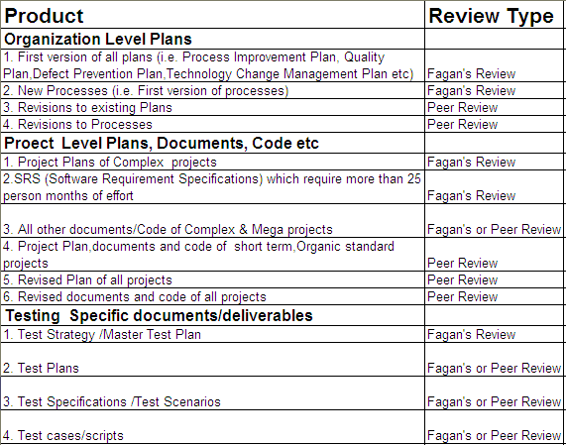
DECIDING TYPE OF REVIEW
A
B
C

Slide 116
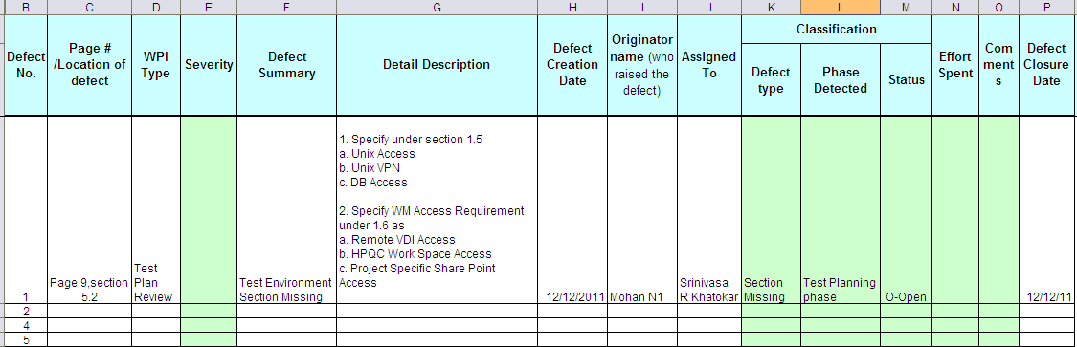
WORK PRODUCT INSPECTION FORM: SNAPSHOT (WPI TAB)
A
B
C

Slide 117
QUIZ QUESTION
Which of the following is not a type of review?
Peer review
Test inspection
Process review
Fagan’s inspection
To measure contribution of each team member
Notes:
Answer: To measure contribution of each team member

Slide 118
QUIZ QUESTION
Which of the following is a type of formal review?
Peer review
Inspection
Test inspection
Peer review
Notes:
Answer: Inspection.

Slide 119
QUIZ QUESTION
Which of the following does not help to decide the type of review required?
Type of work product
Size of work product
Business criticality
Complexity of work product
Notes:
Answer: Size of work Product.

Slide 120
QUIZ QUESTION
Which of the following is not a role in peer reviews?
Facilitator
Author
Reviewer
SQA
Notes:
Answer: Facilitator.

Slide 121
QUIZ QUESTION
In peer reviews, the author:
Approves the product
Initiates the review process
Reviews the product
Signs-off the review summary report
Notes:
Answer: Initiates the Review Process.

Slide 122
QUIZ QUESTION
Which of the following is not true about peer reviews?
The review activity takes more than 2 hours
The reviewer identifies defects based on checklists
Defects are documented in the WPI form
The author takes up correction of defects
Notes:
Answer: The Review activity takes more then 2 hours.

Slide 123
QUIZ QUESTION
Which of the following is not a role in facilitation review?
Producer
Review Leader
Director
Reader
Notes:
Answer: Director.

Slide 124
QUIZ QUESTION
In a facilitation review, the product owner:
Initiates the review process
Distributes material to be reviewed
Manages the entire review process and ensures that review process is adhered to
Participates as an inspector
Notes:
Answer: Initiates the review process.

Slide 125
QUIZ QUESTION
Which of the following is not true about a recorder in facilitation review?
Classifies errors
Understands the material being reviewed
Takes confirmation on each recorded error
Records all review comments
Notes:
Answer:- Understand the material Being Reviewed.

Slide 126
QUIZ QUESTION
Which of the following measurements is not collected from a review process?
Number of defects
Review effort
Rework effort
Testing effort
Notes:
Answer:- Testing Effort.

Slide 127
BENEFITS OF REVIEWS
1
Increase quality, which increases management and customer satisfaction.
2
Help to find errors that cannot be detected through testing.
3
Can find 60-100 % of all defects.
A
B
Review data can assess or improve quality of work product, software development process and review process.
4
5
A way of using the diversity and power of a group of people.
C
6
Reduce rework and thus reduce overall project costs.
Notes:
▪ Reviews increase quality–which increases management and customer satisfaction.
▪ Reviews help to find errors that cannot be detected through testing.
▪ It is observed that reviews can find 60-100% of all defects.
▪ Review data can assess or improve quality of:
o Work product
o Software development process
o Review process
▪ Reviews are a way of using the diversity and power of a group of people to:
o Detect defects (errors)
o Remove defects as close to the point of insertion as possible
o Determine product progress or status
o Identify potential improvements
o Produce technical work of a more uniform and predictable quality
o Gain ownership by the project team
o Establish an audit trail from systems requirements allocated to software through the successive phases of development (traceability)
▪ Reviews reduce rework and thus reduce overall project cost.
o Rework accounts for 44% of development cost while review accounts for only 15%.
o The 44% is split as: Requirement (1%), Design (12%), Coding (12%), and Testing (19%).

Slide 128
BENEFITS OF REVIEWS
125
Relative Costs of Software Defects
100
Relative Cost per Defect
75
A
50
C
25
C
Require ments
Design
Code
Test
Production
Notes:
It is observed that the maximum number of defects are injected during requirements phase itself (Requirements – 56%, Design – 27%, Code – 7%, Other – 10%). Upstream defect removal is 10 to 100 times cheaper. Hence, timely reviews help in keeping project cost under control.

Slide 129
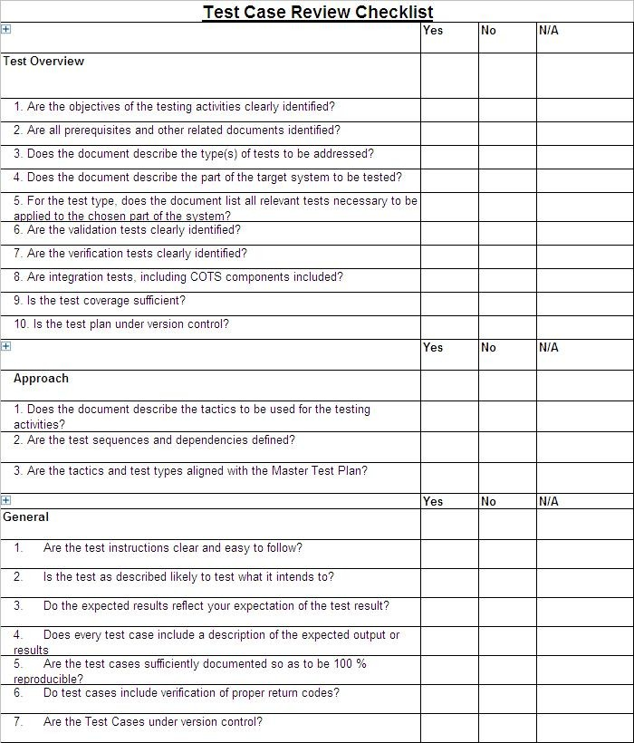
REVIEW CHECKLIST

Slide 130
RETURN ON INVESTMENT (ROI)
Helps to justify the cost of reviews.
The model for ROI bases the savings on the cost avoidance associated with the detection and correction of defects earlier rather than later in the product evolution cycle.
A major defect that leaks from development to testing may cost as much as ten times to detect and correct.
Some defects, undetected in test, continue to leak from test to customer use, and may cost an additional ten times to detect and correct.
A minor defect may cost two to three times to correct later.
Defects leaking from code to test cost nine times more to detect and correct, and defects leaking from test to the field cost thirteen times more.
A
B
C
C
Notes:
Note:
ROI helps to justify the cost of reviews. It is calculated as follows:
ROI = Net Savings / Detection Cost
Where, Net Savings = Cost to Repair – Cost Avoidance
Detection Cost = Cost of Preparation Effort + Cost of Effort to Conduct Review

Slide 131
ACTIVITY
ABC software technology is working on making banking software. The team consists of a Test manager (Thomas), Tester (Gerry) & a Reviewer (Anne). Thomas provides a scenario to Gerry & asks him to prepare test cases & get them reviewed by Anne before starting the testing.
Scenario Details:
The login window of banking application consists of the following three fields.
User Name, Password, OK and Cancel button.
When a user gives the following URL https://www.abcbank.com, a login page opens & prompts for login name & password. When user provides the correct login & password & press ok button, the user account details will be displayed.
Review the above scenario keeping in mind informal & formal reviews process & document the positive & negative test cases.
Tip: Gerry should incorporate valid suggestions that came during review by Anne.

Slide 132
QUIZ QUESTION
Review data can assess/improve the quality of all but one of the following:
Work product
Software development process
Reviewer
Review process
To measure contribution of each team member
Notes:
Answer: To measure contribution of each team member.

Slide 133
QUIZ QUESTION
ROI stands for:
Return Of Investment
Return On Investment
Return On Inspection
Return Of Inspection
Notes:
Answer: Return on Investment.

Slide 134
Introduction to Testing

Slide 135
A test is an activity in which a system or component is executed under special conditions, the results are observed or recorded, and an evaluation is made of some aspects of the system or component.
Testing is not a stand-alone activity, and it has to adapt the development model chosen for the project. In any model, testing should performed at all levels i.e. right from requirements until maintenance.

Slide 136
Functional testing category includes:
Audit and Controls testing
Conversion testing
Documentation and Procedures testing
Error Handling testing
Functional testing
Interface/Inter- system testing
Parallel testing
Regression testing
Transaction Flow testing
Installation testing
Usability testing

Slide 137
Structural testing category includes:
Backup and Recovery testing
Contingency testing
Operational testing
Job Stream testing
Performance testing
Security testing
Stress/Volume testing

Slide 138
Reviews and Inspections are the activities involved in verifying a product against specified requirements.
Peer reviews are the informal review to confirm the understanding of the producer and check for correctness of the product.
Facilitator reviews are the formal review to verify that the artifact complies with the standard of excellence.
Facilitation reviews or inspections are the most rigorous form of reviews which involve structured formal reviews.

Slide 139
Test Technique is used to identify test conditions and test scenarios for writing effective and efficient test cases.
Test design techniques can be classified as specification-based techniques, structure-based techniques and experience-based techniques.

